Slide 1
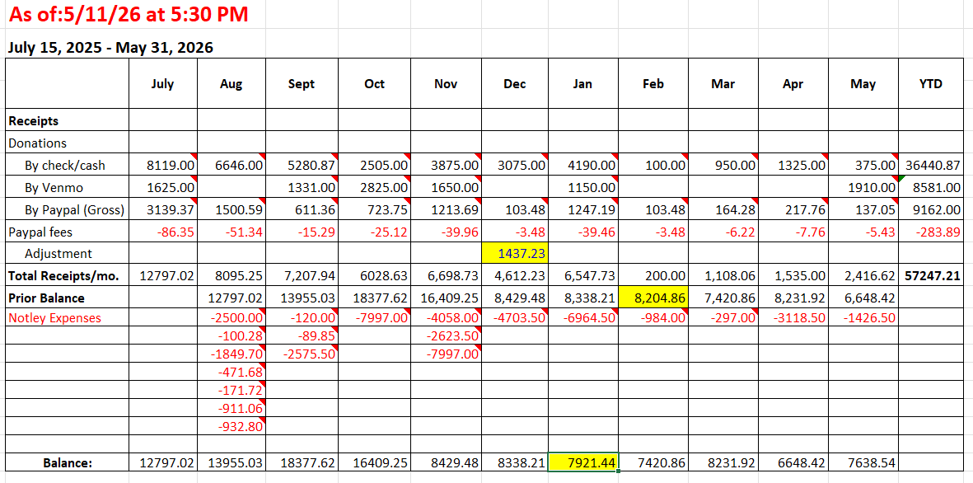
Adjusted down due to double-counting of some sign and t-shirt donation proceeds
Incorrect balance brought forward
Correct balance is now $7355.12

